Slide 2

Moths!
Samuel Mashil

Slide 3

Moths!
Samuel Mashil
Notes:
But it’s a butterfly

Slide 4
Contents
Background
The Pipeline
Extracting features from images
Training and testing the models
The results and findings
Some issues
Pseudoreplication
Class imbalances
Conclusion
The purpose behind my project
Possible future steps

Slide 5
Background
Helicoverpa armigera is one of the world’s worst crop pests, and recently invaded South America.
Hybridised with Helicoverpa zea, spreading resistance genes
Difficult to distinguish – already a long genotyping process
Idea – use machine learning model to distinguish species in the field using nothing but images of the moths’ wings
Notes:
Only getting harder as species hybridise further

Slide 6
Step 0
Get images
Done!
Notes:
Gabby gave me all images and the sequencing to determine which species each individual belonged to
Originally using small previously-collected set of data, then got access to Jacob’s data later on

Slide 7
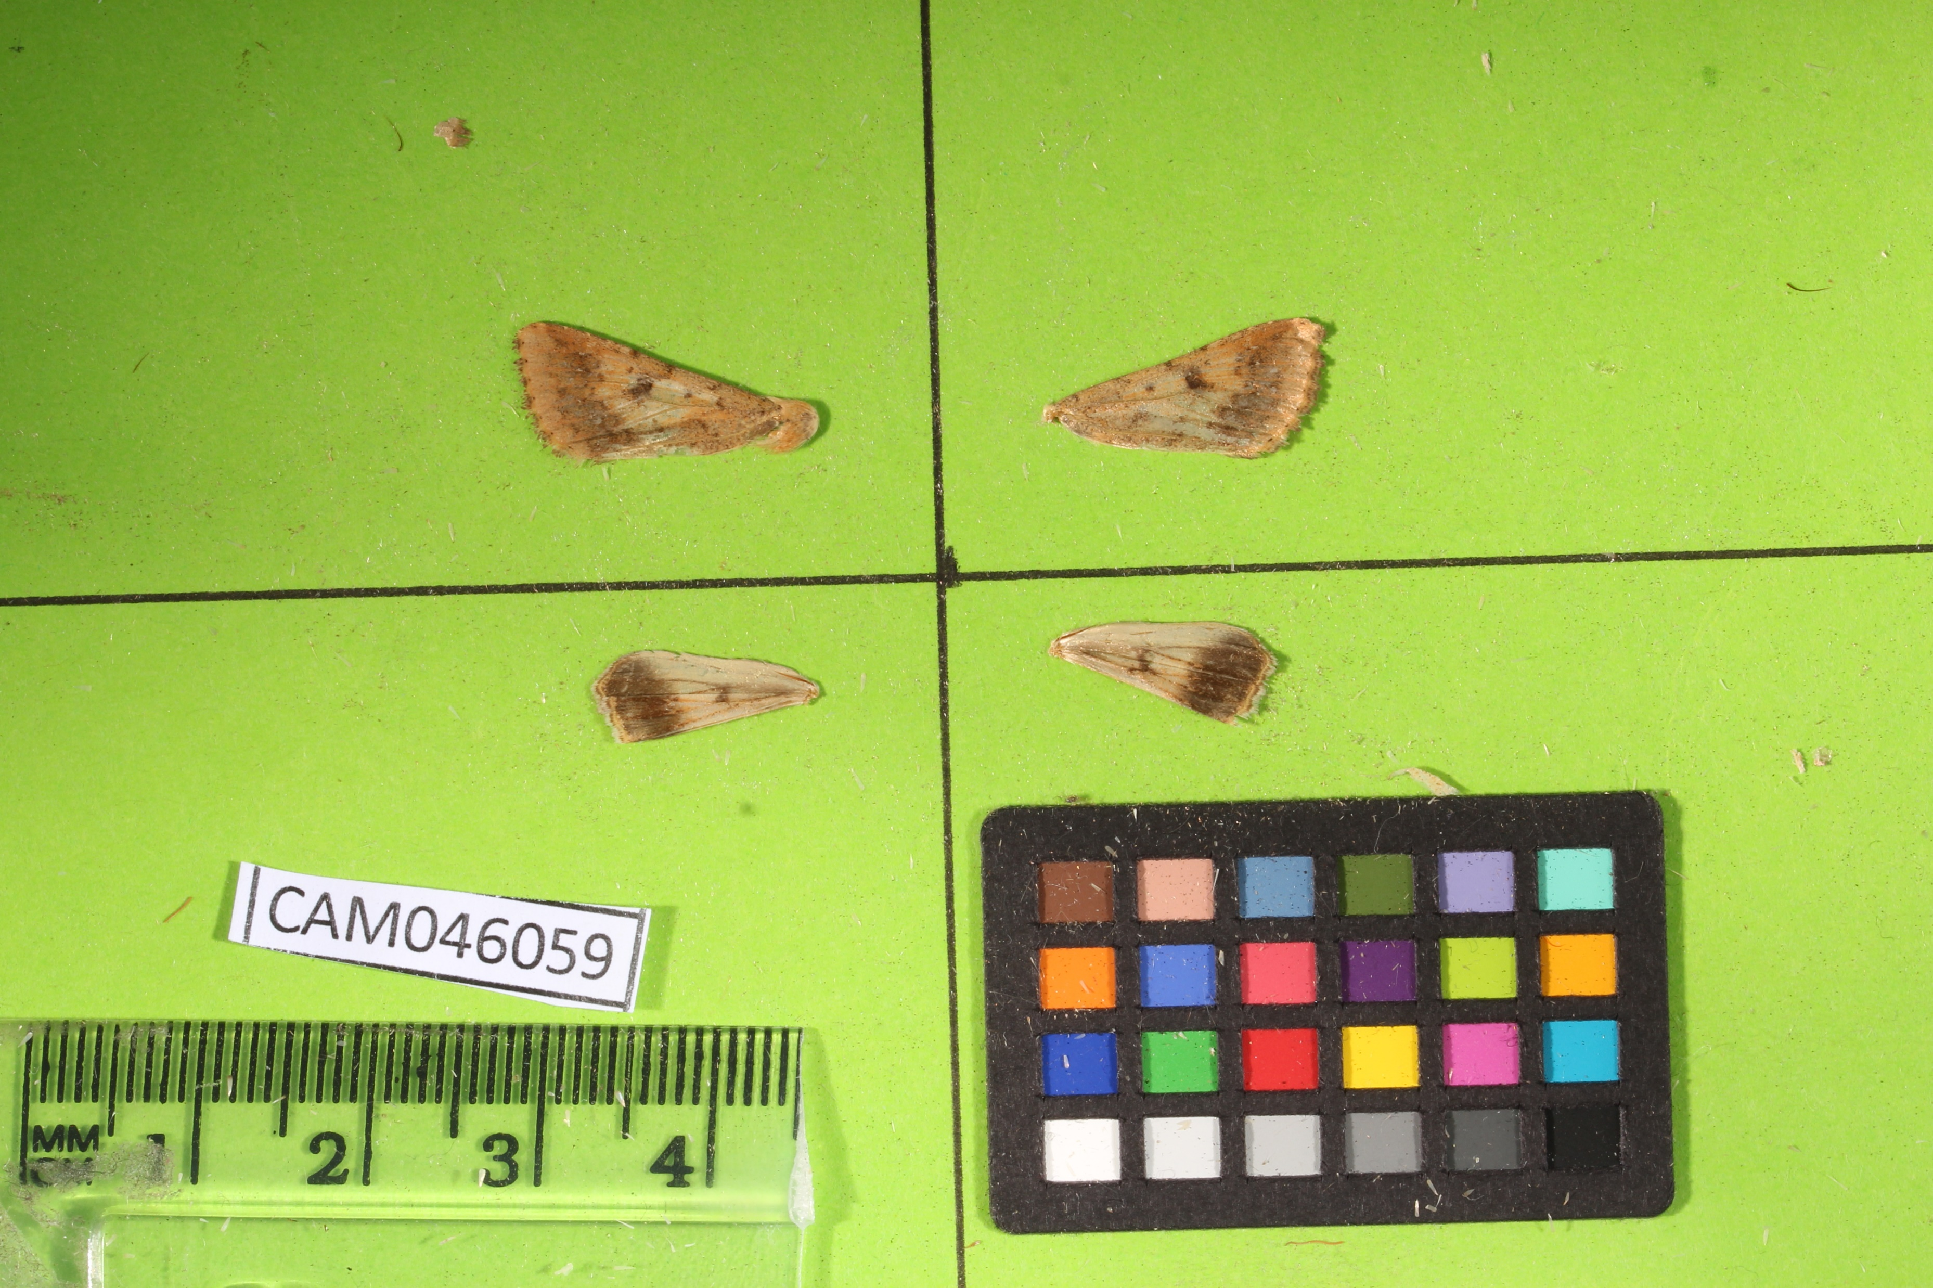
Step 1 Extracting features
Originally done using macros in ImageJ
Crop each image into 4 – one for each wing
Notes:
2 pictures for each individual – for each of ventral and dorsal sides of the wings

Slide 8
Step 1 Extracting features
Originally done using macros in ImageJ
Crop each image into 4 – one for each wing

Slide 9
Step 1 Extracting features
Originally done using macros in ImageJ
Convert RGB photo to HSB and choose Hue channel

Slide 10
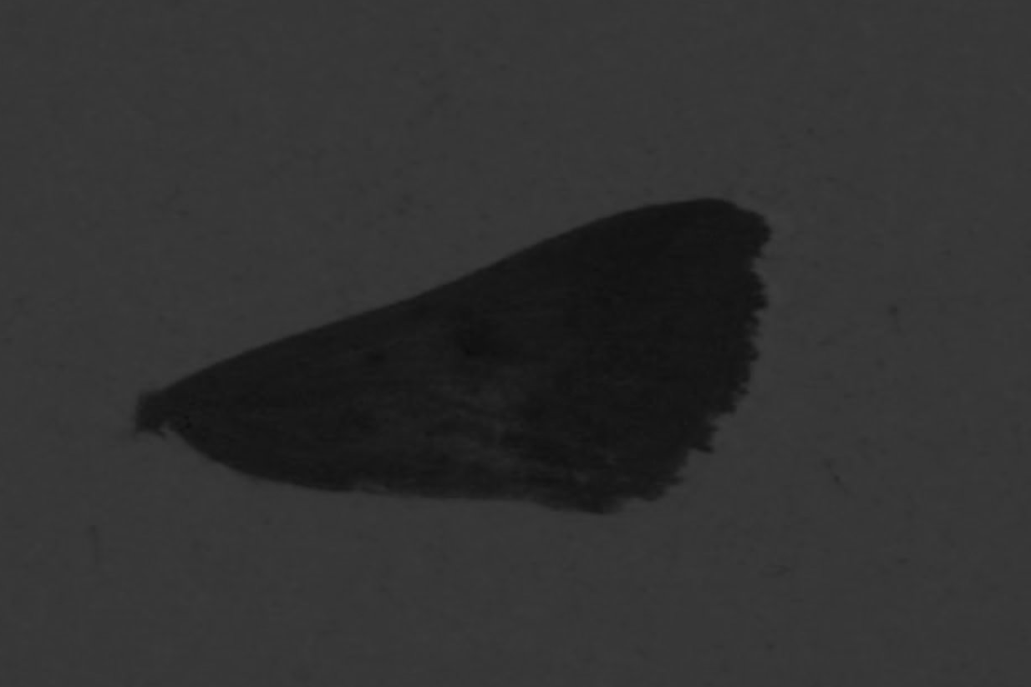
Step 1 Extracting features
Originally done using macros in ImageJ
Convert RGB photo to HSB and choose Hue channel
Notes:
Hue like base colour of each pixel in image

Slide 11
Step 1 Extracting features
Originally done using macros in ImageJ
Create a mask based on a predetermined hue threshold

Slide 12
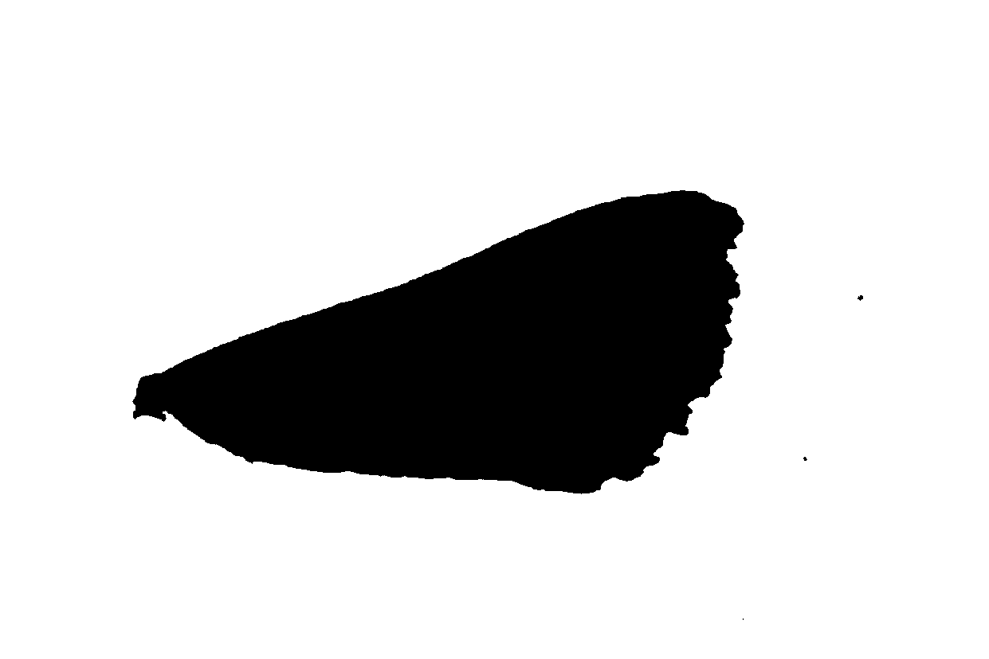
Step 1 Extracting features
Originally done using macros in ImageJ
Create a mask based on a predetermined hue threshold

Slide 13
Step 1 Extracting features
Originally done using macros in ImageJ
Measure the features of the largest shape in the image

Slide 14
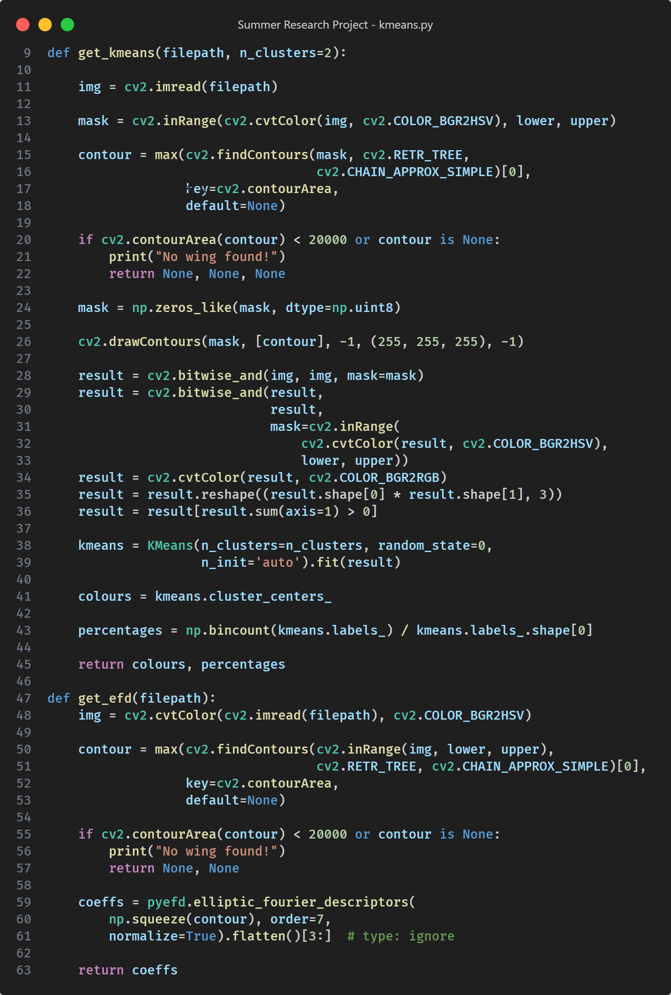
Extracting Shape and Colour
Shape – using elliptical Fourier descriptors.
Colours – using the k-means clustering algorithm.
Done in Python using the pyefd and scikit-learn packages
Notes:
Shapes - Converts a closed shape into numbers by representing it as an infinite sum of ellipses added together of given shapes and sizes.
Colours - Takes the RGB values of every pixel in the image and returns n clusters, each with a central mean colour value - effectively giving the two most prominent colours within the image.

Slide 15
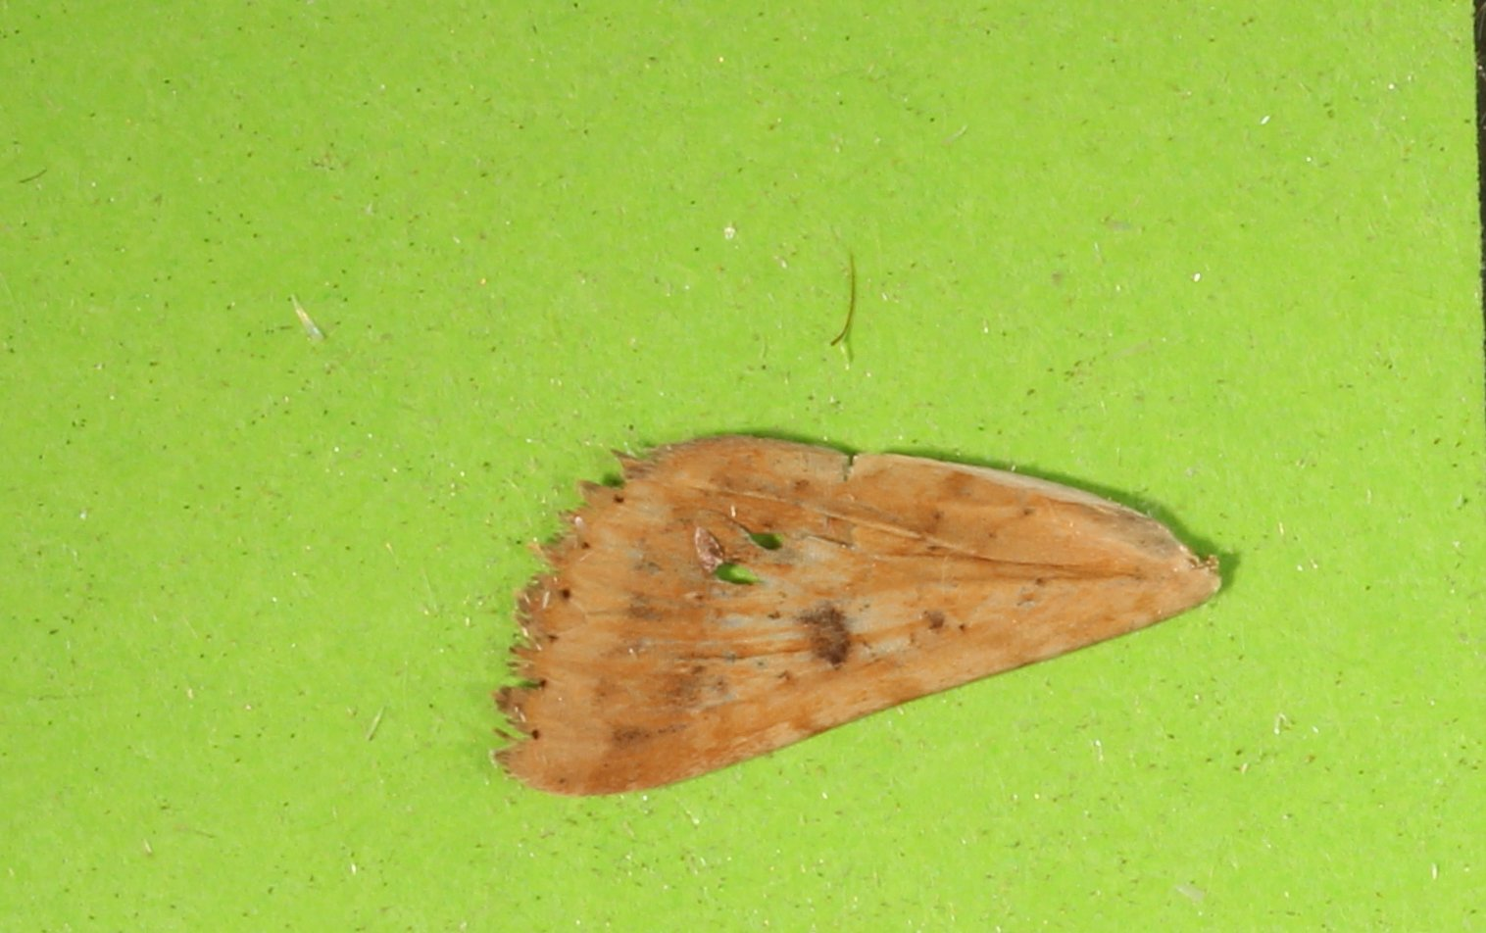
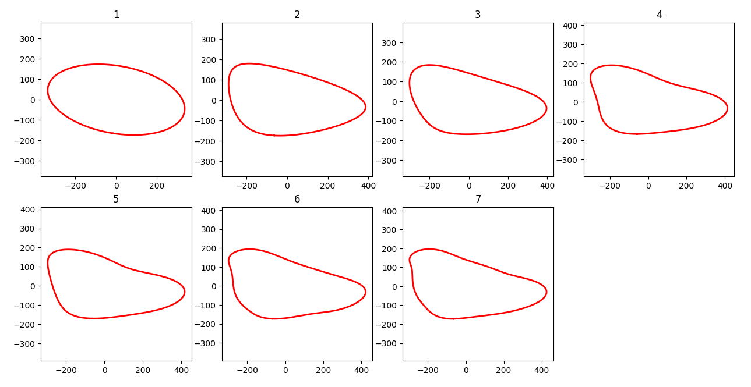
Extracting Shape and Colour
Shape – using elliptical Fourier descriptors.
Colours – using the k-means clustering algorithm.

Slide 16
Extracting Shape and Colour
Shape – using elliptical Fourier descriptors.
Colours – using the k-means clustering algorithm.
Done in Python using the pyefd and scikit-learn packages

Slide 17
Extracted Features
Area
Major/minor axes lengths
Circularity
Feret and minimum feret
Aspect Ratio
Shape
Colours

Slide 18
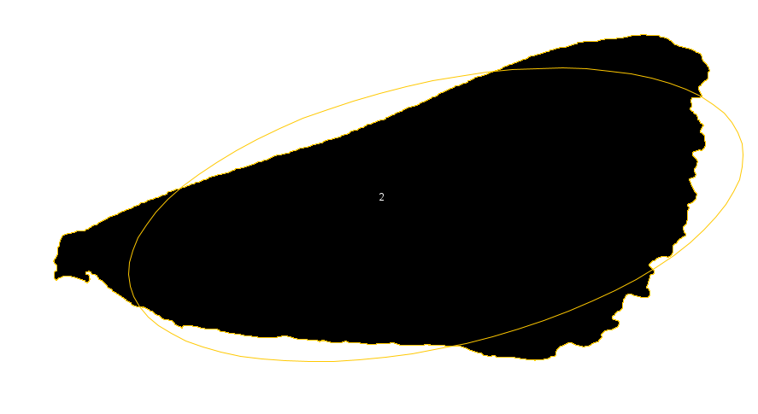
Area
Major/minor axes lengths
Circularity
Feret and minimum feret
Aspect Ratio
Shape
Colours

Slide 19
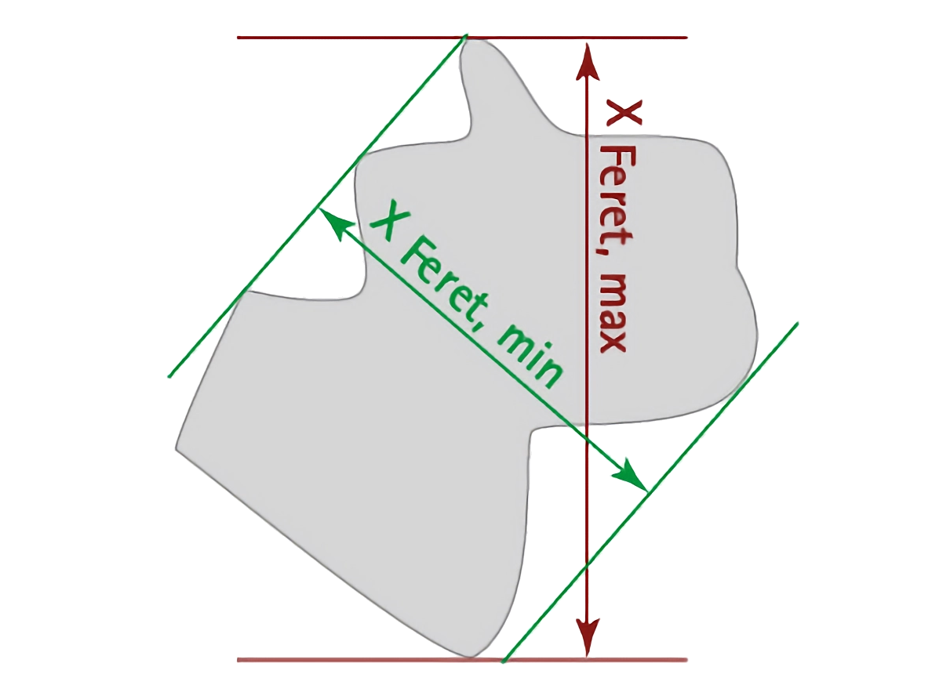
Area
Major/minor axes lengths
Circularity
Feret and minimum feret
Aspect Ratio
Shape
Colours

Slide 20
Extracted Features
Area
Major/minor axes lengths
Circularity
Feret and minimum feret
Aspect Ratio
Shape
Colours

Slide 21

Simple Algorithms
Logistic Regression
Linear Discriminant Analysis (LDA)

Slide 22


Simple Algorithms
Logistic Regression
$$p=\frac{1}{1+e^{−\left(a_{0}+a_{1}X_{1}+a_{2}X_{2}+…\right)}}$$
Linear Discriminant Analysis (LDA)

Slide 23
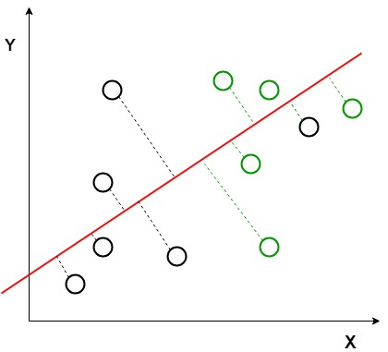
Simple Algorithms
Logistic Regression
Linear Discriminant Analysis (LDA)

Slide 24
Findings
LDA works best
Ignoring hybrids
Logistic Regression: 86.83% ± 1.01
LDA: 89.55% ± 1.29
Including hybrids
Logistic Regression: 76.94% ± 2.92
LDA: 77.82% ± 1.37
Hybrids – admixture between 0.05 and 0.95
Notes:
Explain why accuracy changes - cannot use data that the models been trained on to measure accuracy

Slide 25
Optimisations
Stratified splitting rather than random splitting
Cross-validation – specifically k-fold cross-validation
Less of an issue later in the process
Removes some of the variation in the accuracies
Notes:
Values were originally lower/more varied - used optimisations to produce more meaningful results

Slide 26
Optimisations
Stratified splitting rather than random splitting
Cross-validation – specifically k-fold cross-validation
Less of an issue later in the process
Removes some of the variation in the accuracies
Notes:
Values were originally lower/more varied - used optimisations to produce more meaningful results

Slide 27
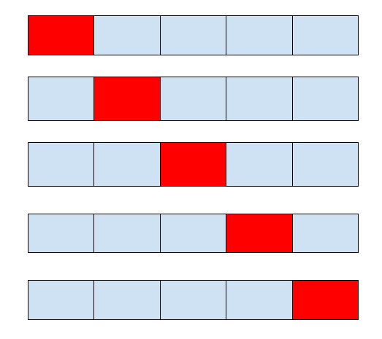
Optimisations
Stratified splitting rather than random splitting
Cross-validation – specifically k-fold cross-validation
Less of an issue later in the process
Removes some of the variation in the accuracies
Notes:
Values were originally lower/more varied - used optimisations to produce more meaningful results

Slide 28
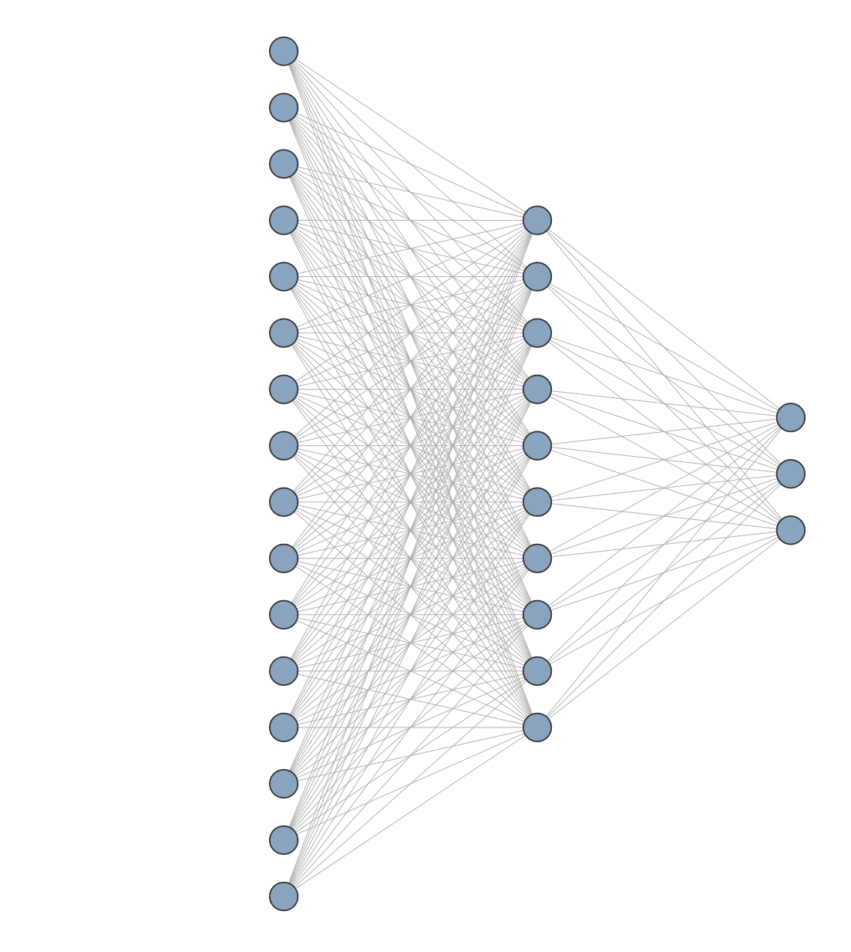
Moving onto neural networks
Using Logistic Regression and LDA as a rudimentary baseline
Initially using the same previously-determined extracted features
Best architecture seemed to be a single hidden layer with 10 nodes
Accuracy: 76.43% ± 2.31
Notes:
Neural network – effectively same process as LR of taking weighted sum, but at every single node
3 output nodes – for arm, hyb, zea
For given set of inputs,
Looked promising
not far off LDA and LR - few optimisations could be made
but also wished to try image-based as well

Slide 29
Image-based neural network
Not so good
Using raw pixel values themselves as the input into the neural network
Average Accuracy: 71.898% ± 2.146
Using pretrained model (VGG16)
Accuracy: 72.606%
Clearly less accurate than using the extracted features
Notes:
Pretrained model – already trained on millions of images from the internet – can then be finetuned for specific use-case

Slide 30

Refining the network
Learning rate scheduler
Early stopping
Dropout
Regularization
Batch normalisation
Different architectures
Gradient clipping

Slide 31
Refining the network
Learning rate scheduler
Early stopping
Batch normalisation
Different architectures
Learning rate scheduler
Early stopping
Dropout
Regularization
Batch normalisation
Different architectures
Gradient clipping
Early stopping
Batch normalisation
Dropout
Regularization
Different architectures
Gradient clipping
Notes:
Normalisation – training data only
Learning rate scheduler helped refinement at end
LRS – adjusting how quickly weights are adjusted: lower takes longer to train but more likely to find an optimal solution
Early stopping rather than training for set number of iterations – stops adjusting weights once changes being made that are specific to training subset, and don’t carry across to the testing set – overfitting

Slide 32
Refining the network
Learning rate scheduler
Early stopping
Batch normalisation
Different architectures
Accuracy: 80.502% ± 2.051
Learning rate scheduler
Early stopping
Dropout
Regularization
Batch normalisation
Different architectures
Gradient clipping
Early stopping
Batch normalisation
Dropout
Regularization
Different architectures
Gradient clipping
Notes:
Normalisation – training data only
Learning rate scheduler helped refinement at end

Slide 34
Notes:
Removed lines for models w/o hybrids
Close LDA makes sense as assumption of normal distribution was valid

Slide 35
Most relevant features
Colour – specifically ventral colour
More green and blue suggests zea
More red suggests armigera
Feret and minimum feret diameters
Higher feret diameter suggests zea
Higher minimum feret diameter suggests armigera
Minor axis length
Larger minor axis length suggests armigera
Area
Larger area suggests zea
Relevant features differed between wings
Notes:
Not putting all numbers here because too many numbers already - hurts my brain
Using LDA model – NN hard to make sense of
Colours on dorsal side – interestingly more green for zea, more blue for arm
Feret, area, etc – same across ventral and dorsal side unsurprisingly
But differs between wings
Front wings – area and feret were by far most important
Rear wings – colour made biggest difference
Differences between wings brought to light issue of pseudoreplication

Slide 36
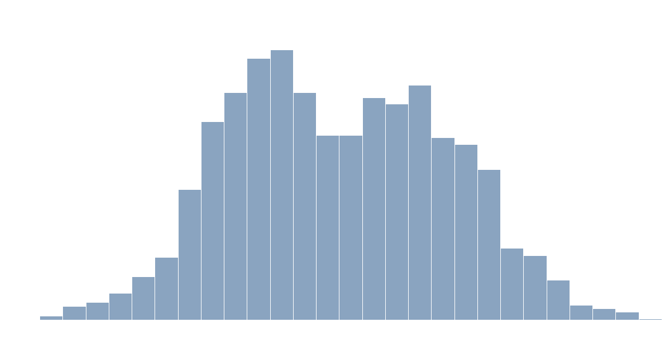

Slide 37
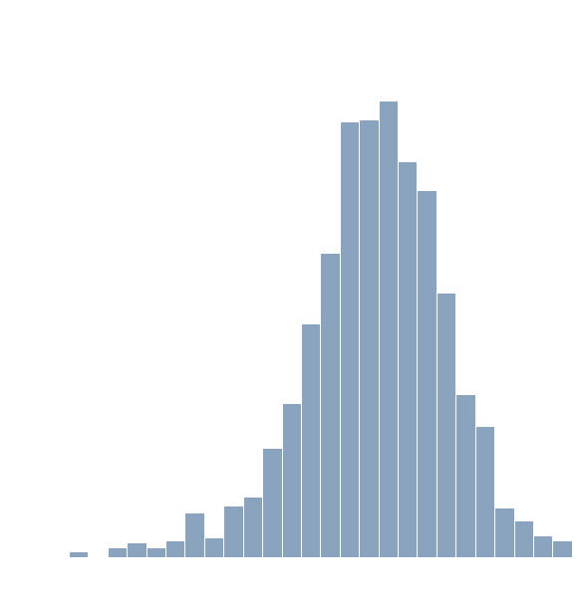
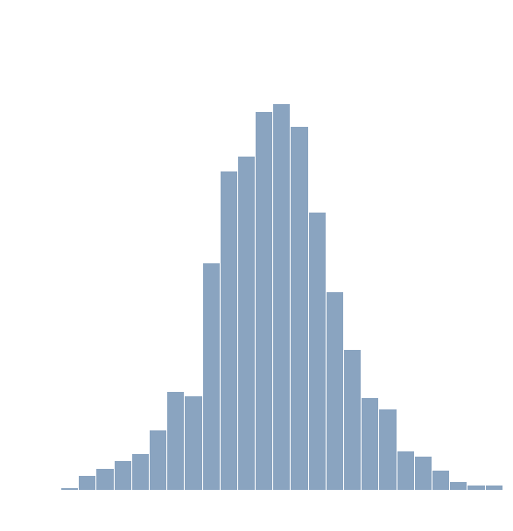

Slide 38
Pseudoreplication (aaah!)

Slide 39
Pseudoreplication
8 samples per individual – samples aren’t independent of one another
Accuracy may potentially be overstated
Best option – grouping all information for a given individual into a single sample
8x less data – performance suffers
Compromise – group samples by wings
Coupled with better splitting across training/testing sets
Replication still exists to a lesser extent, but not across training and testing sets
Notes:
Grouping level 2 technically more than 8x less data as some individuals missing all wings
Explain grouping by wing – both front and rear data for same wing grouped as single sample
All figures shown so far use grouping by wing
Training/testing also includes validation in case of neural networks

Slide 40
Class Imbalance Over 72% armigera!
Notes:
72.56479% of data is arm – makes 80% accuracy less impressive

Slide 41

Baselines
Zero Weight Baseline – always predicting the majority class
$72.6\%$ accuracy
Random Rate Baseline – guessing randomly, but weighted according to class balance
${0.7256}^{2}+{0.1403}^{2}+{0.1340}^{2} = 0.56421897822≈56.4\%$
Notes:
In theory, NN is doing better than both baselines, so it’s definitely doing something at least, but better way to tell is to manually balance classes

Slide 42
Balancing the Classes
Over-sampling or under-sampling: both give similar results
Accuracy: 65.31% ± 6.91
Baselines in this case would be 33% (zero-weight) or 32.67% (random rate), so performance is much better.
Notes:
80% accuracy from before was not just due to class imbalance, and can be trusted
All this shows accuracy isn’t the best/most representative measurement

Slide 43
Performance Metrics
Accuracy isn’t the most representative measure
Confusion Matrices
Original |  | Predicted
 | Original | Armigera | Hybrid | Zea
True | Armigera | 15561 | 119 | 918
 | Hybrid | 1929 | 585 | 460
 | Zea | 1462 | 99 | 1470
Balanced |  | Predicted
 | Original | Armigera | Hybrid | Zea
True | Armigera | 9638 | 4312 | 2709
 | Hybrid | 3850 | 8925 | 3884
 | Zea | 1416 | 2556 | 12687

Slide 44
Precision and Recall
Precision: the percentage of results which are relevant for a given class
Recall: the percentage of total relevant results correctly classified
Higher precision and recall for armigera isn’t necessary bad – it’s what we wish to detect
Original | Precision | Recall
Armigera | 0.821 | 0.938
Hybrid | 0.729 | 0.197
Zea | 0.516 | 0.485
Balanced | Precision | Recall
Armigera | 0.647 | 0.579
Hybrid | 0.565 | 0.536
Zea | 0.658 | 0.762
Notes:
Put definitions simply
Balance of data in training set can be manually adjusted to give desired relative precision and recall across all three categories

Slide 45
Conclusions
Machine learning works!
Whilst not perfect, the final model still performs its role as an aid to farmers in the field
Could be improved with more data or further refinement
Future ideas:
Explore models deeper – how each features individually affects each models
How these effects differ across wings/samples
Finetuning models accordingly to better fit each wing specifically
Notes:
Refer to original goal of detecting species using just wings
Makes farmers lives easier
Future ideas (if I had more time)
Effects of individual features could be used to finetune models further thanks to better understanding
On that note, I don’t have more time, so thank you all for an enjoyable 8 weeks, to Api and Gabby specifically, and to all of you for listening

